Slide 1




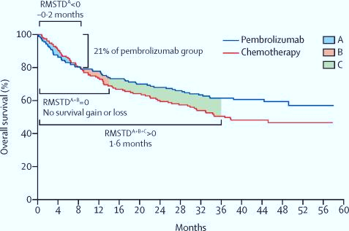
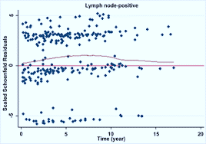
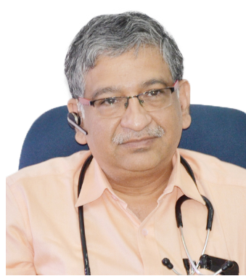

TATA MEMORIAL CENTRE
ADVANCED CENTRE FOR TREATMENT, RESEARCH & EDUCATION IN CANCER (ACTREC)
WORKSHOP ON
SURVIVAL ANALYSIS: How and What!
3rd February, 2024 9.30 AM- 4.00 PM
Prof. Sudeep Gupta
Patron
Director
Tata Memorial Centre
Mumbai
Mrs. Sadhana Kannan
Program Director
Scientific Officer ‘F’ (Biostatistics)
ACTREC, Tata Memorial Centre
Mumbai
Core Committee
Prof. Sudeep Gupta
Mrs. Sadhana Kannan
Dr. Priya Tiwari
Click the link below to register
https://forms.gle/eqA4ngQfADkzjMSA7

Slide 2

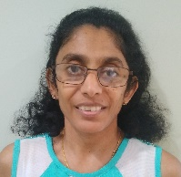
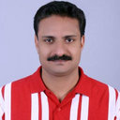
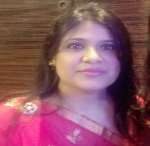
SURVIVAL ANALYSIS: How and What!
3rd February 2024 9.30 AM- 4.00 PM
Welcome Note
On behalf of Indian Society for Medical and Paediatric Oncology (ISMPO), we welcome the delegates to ISMPOCON 2024 for a workshop on ‘SURVIVAL ANALYSIS: How and What!’.
The one-day workshop will delve into the basics of survival analysis, methods used for analyzing failure time data and Restricted Mean Survival Time (RMST). RMST though a less well-known survival metric, is an alternative measure for hazards ratio, medians and landmark survival as a summary measure of treatment effect that may not be tenable in absence of proportional hazards. Non-proportional hazards are frequently observed in cancer immunotherapy trials due to the long-term survival and delayed clinical benefits. The workshop is a blend of concepts, mathematical background, implementation and interpretation. Critical appraisal of land-mark clinical trials in the field of oncology with respect to survival analysis are the key focus of the workshop.
Faculty
Mrs. Sadhana Kannan Dr. Anant Ramaswamy
Scientific Officer ‘F’ (Biostatistics) Professor, Medical Oncology
ACTREC, Tata Memorial Centre, Tata Memorial Centre
Mumbai Mumbai
Dr. Revathy Ananthakrishnan Dr. Binu S.V
Director, Biostatistics Professor, Biostatistics
Bristol Myers Squibb, NJ, USA NIMHANS, Bangalore
Neha Singh
Sr. Principal Biostatistician
Paraxel International

Slide 3
SURVIVAL ANALYSIS: How and What!
3rd February 2024 9.30 AM- 4.00 PM
Scientific Program
Time | Topic
9.30 am-9.45 am | Opening Remarks Dr.. Sudeep Gupta , Director, Tata Memorial Centre
9.45 am-10.30 am | Introduction to Survival Analysis Sadhana Kannan
10.30 am - 11.15 am | Cox Proportional Hazards (PH) model Dr. Binu, V.S
11.15 am to 11.30 am | Tea Break
11.30 am - 12.15 pm | Restricted Mean Survival Time Neha Singh
12.15 pm – 12.45 pm | Design of Immuno-Oncology trials under Non-PH Dr. Revathi Ananthakrishnan (Recorded session)
12.45 pm – 1.30 pm | Lunch Break
1.30 pm - 3.30 pm | Panel Discussion of landmark clinical trials Keynote- 177 (Colorectal Cancer) Keynote- 394 (HCC) Moderators : Mrs. Sadhana Kannan, Neha Singh Dr. Anant Ramaswamy
3.30 pm -4.00 pm | Tea Break & Networking
Venue
Mini Auditorium, Paymaster Shodhika, ACTREC Kharghar, Navi Mumbai
Who can apply
Delegates who are ISMPO members are eligible to attend the post lunch session that is the key focus of the workshop ‘Critical appraisal of land-mark clinical trials in the field of oncology with respect to survival analysis’.
Morning session will be on hybrid mode and will be open to all. Registration is mandatory.
Registration
Registration is free of cost but compulsory. To register for the course, please click on the link: https://forms.gle/aFSK5WMtTwVAm6p58
Kindly note that the number of seats is limited to 30 for the post lunch session. Decision of the Conference secretariat will be final.

